Slide 1
Focus and Impact
Senior Promotion Workshop Nov 22 2019
Edward Etchells, MD FRCPC MSc
Senior Mentor, Centre for Quality Improvement and Patient Safety (CQUIPS)
Mentorship Coordinator, Division of General Internal Medicine
Department of Medicine, University of Toronto

Slide 2
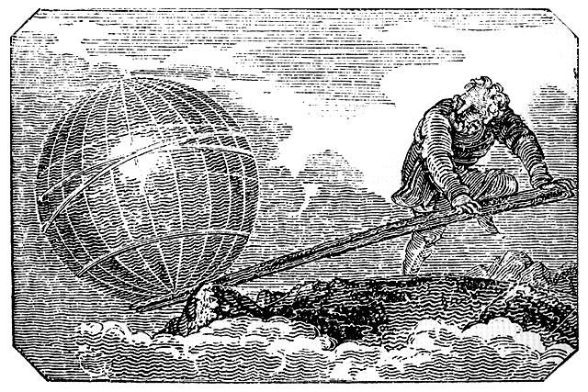
Notes:
We want to change the world.
Creative professional activity is about making the world a little bit better.
Archimedes also wanted to change the world, and he did so by articulating the theory of levers. With some focused energy and a well positioned lever, Archimedes asserted that he could change the world.
For you to be successful you need to focus your energy (this session) and understand your levers (next few sessions)
Focus is essential for impact
Archimedes famously suggested that with focus applied to a lever, he could move the world. (This was a slight exaggeration, but Archimedes would likely have been successful if he applied for senior academic promotion.)

Slide 3
My Focus
My focus is using Rx vigilance and staffing redesign to reduce potentially harmful medication errors during prospective and retrospective medication reconciliation, as mandated by ISMP-C and the SHM.

Slide 4
Focus
Bring the reader into your world
Tell a patient story in plain language
No abbreviations
No jargon

Slide 5
My Focus – Better Version
Patients might get the wrong medications when they are admitted or discharged from hospital. This can cause harm to patients.
My scholarly focus is reducing such errors.

Slide 6
Activity #1
What is the focus of your scholarly work? (Max. 250 words) ?
2 minutes then 2 minutes pair and share

Slide 7
Notes:
We want to change the world.
Creative professional activity is about making the world a little bit better.
Archimedes also wanted to change the world, and he did so by articulating the theory of levers. With some focused energy and a well positioned lever, Archimedes asserted that he could change the world.
For you to be successful you need to focus your energy (this session) and understand your levers (next few sessions)
Focus is essential for impact
Archimedes famously suggested that with focus applied to a lever, he could move the world. (This was a slight exaggeration, but Archimedes would likely have been successful if he applied for senior academic promotion.)

Slide 8
Impact
Patient care is better because of your scholarly activity
Notes:
Big challenge for EQUIP is that impact might not be defined the same way at each institution.

Slide 9
Activities/Evidence of Impact
Almost Anything!
Examples: page 17, U of T Manual for Academic Promotion

Slide 10
My impact
I joined the ISMP-C in 2015. I led the QI subcommittee on MedRec. We secured grants from CSIM to address unintentional medication discrepancies with a focus on SGLT2 inhibitors, and CYP3A4 inducers. We wrote papers in CJGIM, JGIM, AIM and AJM. I gave the plenary lecture at CSIM in Hamilton and London. I have worked with F. Crabtree, BJ Wilks and A. Punter on educational material.

Slide 11
Describe Your Impact
1. Make the reviewer’s job easy
Start with impact summary statements
No jargon
Few or no abbreviations
State the scope clearly. (London…Hamilton?)
2. Tell your story
story line(s) weave around your focus

Slide 12
Better – Impact summary statement
Since 2015 I have given 3 provincial invited presentations, participated in 1 national guidelines committee, and shared educational material with 4 international medical educators.

Slide 13
Better – Tell your story
In 2015 I did an drug safety audit at Sunnybrook, Toronto. We found many errors at the time of admission. The results led to a change in pharmacy staffing and discharge summary formats at Sunnybrook. We presented the audit at a 2016 national drug safety meeting. We shared our audit methods with colleagues in three Canadian cities and one American city.

Slide 14
One More Tip
Do not try to pigeon hole activities into the three ‘categories’ of CPA.

Slide 15
Activity #2 - Impact
Describe your impact
Start with a impact summary
Leave the #s blank, fill them in later
Tell your story
There may be more than one story line around your focus
For each story line, cite:
Evidence of impact
Scope of impact
3 minutes then pair and share

Slide 16
Thank you
Edward Etchells, MD FRCPC MSc edward.etchells@sunnybrook.ca

