Slide 1
2016 New Faculty Orientation
Department of Medicine
University of Toronto

Slide 2
WELCOME!

Slide 3
Overview of the Day
U of T & DoM 101
The Academic Life Cycle
Academic Position Descriptions
Continuing Faculty Appointment Review
Junior Promotion
Expectations of Academic Clinical Faculty
Teaching & Education – Dr Martin Schreiber
Break 10 mins
Research – Dr Michael Farkouh
Creative Professional Activities (CPA)
Administrative service
Looking ahead to Senior Promotion
Your Curriculum Vitae
Break 10 mins
Clinical Faculty and Departmental Policies
Relationships with Industry – Dr Jeannette Goguen
Departmental Website & Social Media
Faculty Wellness
Lunch (12-1)
Mentorship Workshop – Dr Sharon Straus
Closing Remarks

Slide 4
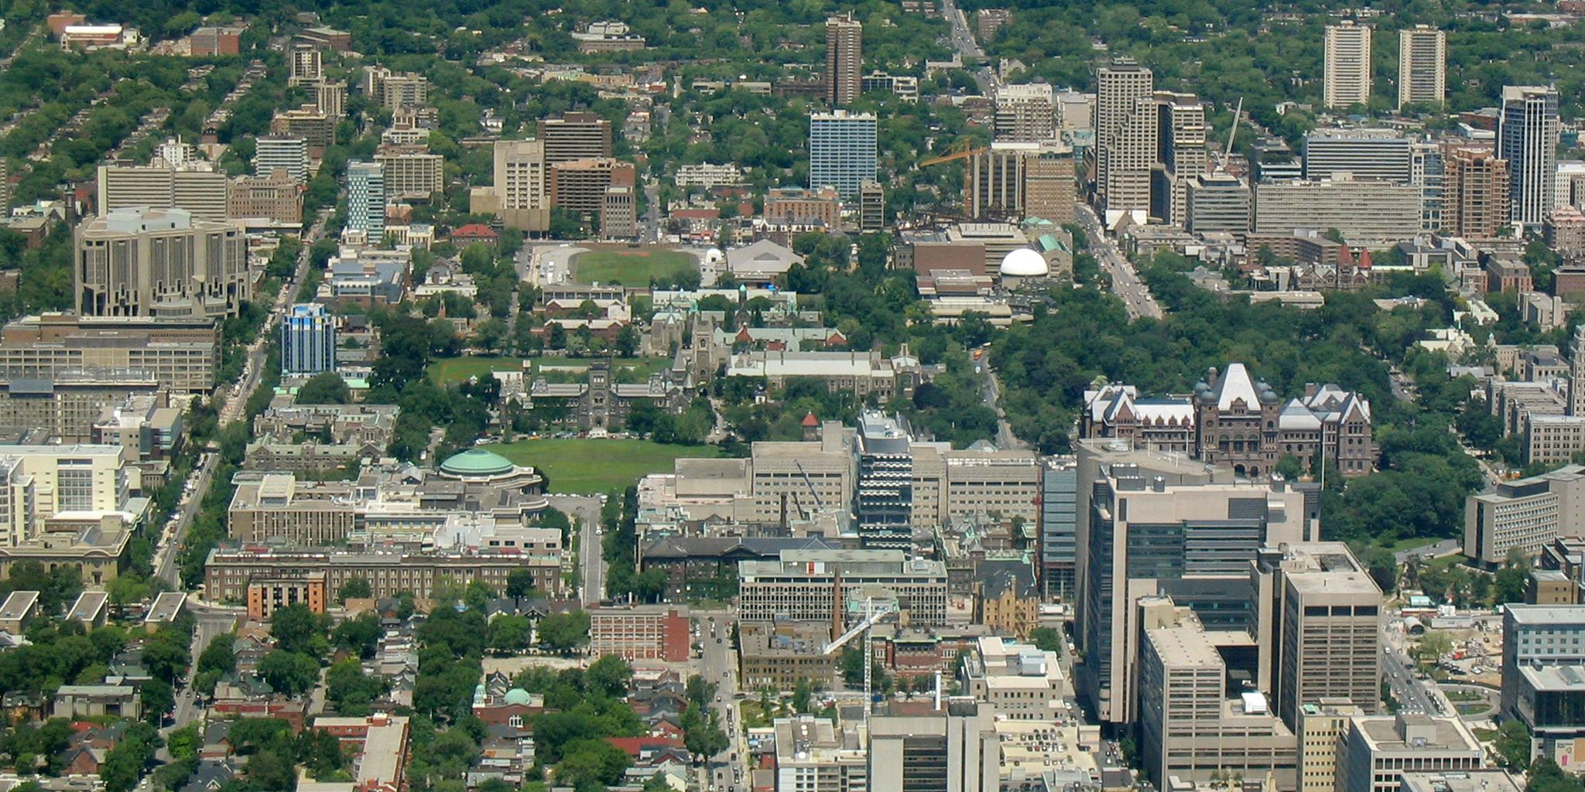
Overview of U of T & Department of Medicine
2016 new faculty orientation

Slide 5
Major discoveries & milestones
1921 Insulin (Banting & Best)
1930 Pablum (Tisdall, Drake & Brown)
1936 Purification of Heparin (Scott & Charles)
1936 First Mobile Transfusion Unit (Noman Bethune)
1951 First Electronic Heart Pacemaker (Bigelow)
1961 Discovery of Stem Cells (Till & McCulloch)
1981 The Glycemic Index (David Jenkins)
1981 First Single Lung Transplant (Pearson & Cooper)
1984 T-Cell Receptor Gene (Tak Mak)
1988 First Nerve Transplant (Hudson & MacKinnon)
1989 The Cystic Fibrosis Gene (Lap-Chee Tsui)
1991 Cell Receptor Discoveries Enable Development to New Cancer Drugs (Pawson)
1995 Discovery of Genes Responsible for Early-onset Alzheimer’s (St. George-Hyslop)
2010 Stem Cells Restore Sight to Blind Mice (van der Kooy)
2015 Opening the Blood-Brain Barrier (Mainprize)

Slide 6
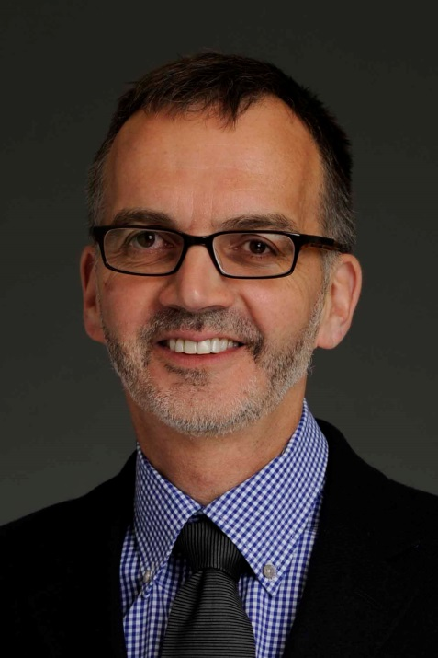
University of Toronto
Governing Council
President Meric Gertler
VP
VP & Provost
VP
VP Research
Dean
Dean
Dean, Faculty of Medicine
Chair
Chair, Dept of Medicine
Chair
PICs
Departmental Division Heads
Vice Chairs
Committees

Slide 7
The Department of Medicine Today
ONE DoM & training program across 6 fully-affiliated teaching hospitals
~ 1,400 faculty members (~ 800 full-time)
~ 1,000 postgraduate trainees (core residents, sub-specialty residents, clinical fellows)
We train ~ 1:2 Ontario’s & 1:3 Canada’s internal medicine specialists
19 divisions (palliative medicine)
Rank 6th world-wide for clinical medicine

Slide 8
You have 2 Appointments
University faculty appointment
Rank (Lecturer to Full Professor)
Academic Position description
License to practice medicine (CPSO)
Affiliated hospital appointment
Clinical appointment (e.g. Courtesy, Active staff)
Credentialing (CPSO/CMPA, resource impact)
Chair’s office
Departmental / Hospital Division Heads
PIC’s office

Slide 9
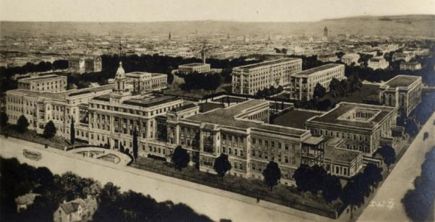
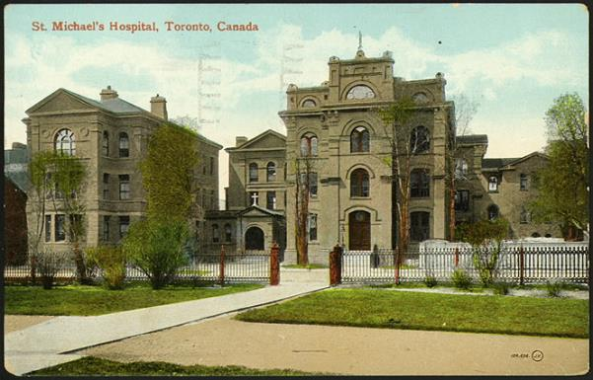
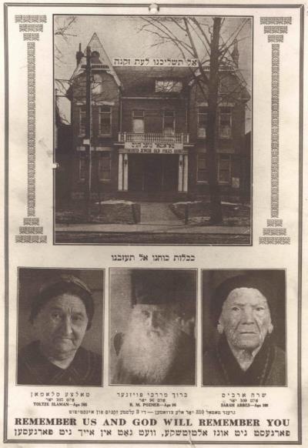
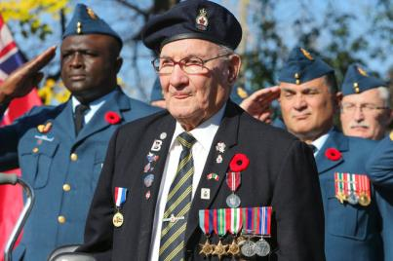
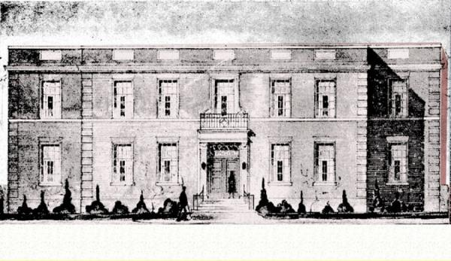
Fully Affiliated Teaching Hospitals
Toronto General Hospital (1819)
Woman's Medical College (1883)
Women’s College Dispensary 1891
St Michael’s Hospital (1892)
Toronto Western Hospital (1896)
Toronto Jewish Old Folks Home (1918)
Baycrest Centre for Geriatric Care (1967)
Mt Sinai Hospital (1922)
Sunnybrook Veteran’s Hospital (1946)

Slide 10
MISSION
Through the discovery, application, translation and communication of knowledge, we prepare future physician leaders, contribute to our communities and improve the health and health care experiences of individuals and populations.
We meaningfully impact health through international leadership in education, research and the translation of new knowledge into better care and health outcomes
VISION

Slide 11
STRATEGIC PRIORITIES
Patients’ preferences & priorities drive our work
Equity, diversity and professionalism
Social accountability
Training to meet population needs
Generation & translation of new knowledge to impact health
Inclusiveness (all our faculty members, inter-professional colleagues, hospital & university identities)
Mentorship across the academic lifespan
Raise funds to achieve our goals

Slide 12
Academic Life Cycle
2016 new faculty orientation

Slide 13
Types of appointments:
Full time clinical
Part time clinical
Adjunct clinical
Training
Recruitment
(rank, position description, hospital appointment)
Annual review
(hospital or divisional level)
Continuing faculty appointment review
Junior promotion (Lecturer to Assistant Professor)
Senior promotion

Slide 14
Academic position descriptions (a.k.a. academic job descriptions)
University requirement for full time & part time clinical academic appointees
Department-specific
Intended to clarify:
Amount of time the individual will devote to each of scholarship, teaching (formal and informal), clinical activities and administrative service
Amount of time protected for scholarship
Focus of scholarly work (research – all types - and/or creative professional activity, CPA)

Slide 15
Distribution of Academic Position Descriptions in DoM
http://www.deptmedicine.utoronto.ca/academic-position-descriptions

Slide 16
The First Years (the probationary period)
New appointments are probationary for three to five years
Continued appointment beyond this time is contingent upon a successful Continuing Faculty Appointment Review (CFAR)
CFAR usually takes place 3 years from initial appointment
Timing depends on initial month of appointment, leaves of absence during this period

Slide 17
CFAR - Purpose

Slide 18
CFAR – What are we looking for?
Is the individual advancing as expected for their academic position description & initial rank – Academic Planning Document
If not why not?
What actions could be taken to address barriers or further enhance likelihood of career success?
Has the individual consistently demonstrated professional behaviour?

Slide 19
Potential ‘early career’ challenges
Faculty member level
Lack of insight re what they are passionate about / want to spend time doing
Wrong academic position description
Appreciation of one’s strengths and weaknesses - work on both
Failure to balance clinical commitments with expectations for scholarship*
Failure to use mentors
Failure to plan both for short term and longer term (what’s the long term goal?)
Lack of visibility outside of the institution
Inappropriate use of the words ‘yes’ and ‘no’
Poor use of/protection of ‘protected time’
Departmental leadership level
Inadequate investment (mentorship, resources, infrastructure, protected time)
Misalignment of what is needed with what is rewarded
*sometimes within scholarly work

Slide 20
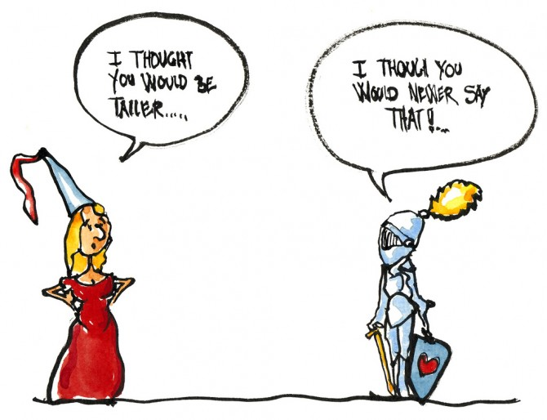

Slide 21
DIRECT REPORTS HAPPY

Slide 22
Continuing Faculty Appointment Review
Annual success rates are high (~ 90%)
Researchers often require more time
Re-review in 1-2 years
Position Description | Pass | Probation*** | Total
CT | 15 | 1* | 16
CQI | 8 | 0 | 8
CI/CS (research) | 8 | 3** | 11
CE | 1 | 0 | 1
Total | 32 | 4 | 36
*requires faculty development regarding teaching
**degree not completed; balance of time
***change in academic position description

Slide 23
Expectations of an academic clinical faculty member
2016 new faculty orientation

Slide 24
Clinical Faculty are expected to…
Provide high quality clinical care
Be effective teachers
Amount & focus will vary by academic position description (link)
Be role models to trainees
Conduct scholarly work
Contribute administrative service (NOT first 3 years on faculty)
…to varying degrees based on academic position description

Slide 25
You have you chosen an academic career. Why?

Slide 26
Scholarly Activities
The DoM recognizes that scholarship comes in many forms and includes:
Sustained excellence in teaching
Research (all types)
Creative professional activities (CPA)

Slide 27
Teaching & education
2016 new faculty orientation – dr. martin schreiber

Slide 28
Break
10 minutes

Slide 29
Research (any type)
IMPORTANCE & IMPACT
Grant Funding
Contribution & independence if large team (or working with former supervisor, or industry sponsored etc.) e.g. role in design, conduct, analysis, publication?
Supervision of trainees
Numbers, levels, their success (senior author publications)
Dissemination of Findings
Publications (incl. relative importance of journals, h-index/citations, book chapters, invited editorials, accompanying editorials, presentations of work at major meetings – published abstracts)
Invited research presentations (national, international)
Presentations of accepted abstracts
CME and lay presentations
Graduate supervision – evaluations

Slide 30
Creative Professional Activities (CPA)
CPA refers to activities that:
Contribute to the development of professional practices
e.g., health policy development, regulatory committees, setting of standards
Enhance exemplary professional practice
teaching techniques, educational innovations, curriculum development
models of care innovations, e.g. role of EMR prompts, standardized pathways, pre-printed patient ‘order sets’, on quality and safety of inpatient care or resident experience
leadership in development of professional practice (tools to enhance physician communication, professionalism
Represent professional innovations and creative excellence
e.g., patient videos, curriculum innovations, use of digital technologies or other devices to improve care and outcomes

Slide 31
CPA
CPA activities should have a thematic connection
e.g., focus is “addressing low value care“
Choosing Wisely project that leads to a publication
Membership on a national specialty committee related to Choosing Wisely
Teaching on the topic locally or beyond
Invitations to talk about the work in other provinces or countries In total, these activities can provide a substantive picture of impact under CPA because they have a clear thematic connection.

Slide 32
CPA
For promotion, one must demonstrate impact of CPA beyond the local environment (nationally, internationally):
Awards, honours, invited presentations
Invitations to consult/advise, e.g. re a QI initiative or educational innovation, at another institution
Appointment to decision making bodies, advisory committees, or task forces related to the focus of one’s CPA
Should all be documented in your CV…

Slide 33
Administrative Service
Administrative or committee work within the University and to external agencies that furthers the scholarly and educational goals of the University
Expected service (NOT FIRST 3 YRS unless totally aligned with your goals)
Significant service - quality/impact most important

Slide 34
Looking ahead to Senior Promotion
Assistant to Associate Professor
Associate to Full Professor

Slide 35
Criteria for Senior Promotion
 | Research | CPA | Teaching | Administrative Service
Excellent | MUST be deemed excellent in AT LEAST ONE of these areas |  |  | Not a criterion for promotion but expected to exist
Competent |  |  | MUST be AT LEAST competent in teaching
Not Applicable
CT
CQI
CE + CI
CS

Slide 36
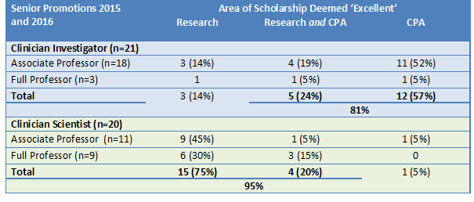
CI vs CS

Slide 37
Why bother?
Time for reflection – looking back on what you have accomplished and feeling proud
Acknowledgement by your peers, your community of your contributions and excellence
Eligibility for leadership roles if desired
It feels really good and makes your parents / family proud!

Slide 38
Your Curriculum Vitae
2016 new faculty orientation

Slide 39
CV
Start NOW – update regularly!
No more WebCV, but template has not changed (link) – word document for now
Research, CPA and Teaching Statements
CPA goes directly into your CV
Quality > quantity

Slide 40
What your CV tells others about you
Are you organized and attentive to detail?
U of T faculty of medicine template
No typos, up to date (journal submissions)
Focused (thematic)
Are you a finisher?
The right balance of grant/presentations to publications
Demonstration of impact (eventually!)
No padding – reflects badly (don’t do)
Collaborative?
Leader? Role on projects, publications, guidelines, etc

Slide 41
Clinical Faculty and Departmental Policies
2016 new faculty orientation

Slide 42
Clinical Faculty Policies
First 3-5 years are probationary
Full time faculty must have academic position description & participate in “conforming practice plan”
Access to Academic Tribunal and Grievance Committees
Policy for Clinical Faculty – Procedures manual: http://www.library.utoronto.ca/medicine/ProceduresManualCF.pdf
Great bedtime reading!

Slide 43
Faculty Perks
Benefits (Tuition – yourself/dependents, Hart House, Athletic Club, Faculty Club, U. of T. courses)
http://www.hrandequity.utoronto.ca/faculty-librarians/benefits.htm
http://www.facmed.utoronto.ca/education/educational-services-support
http://www.facmed.utoronto.ca/faculty-staff/university-employee-services
http://www.facmed.utoronto.ca/faculty-staff/clinical-faculty-resources
Scholarship program for dependants
http://www.adm.utoronto.ca/awards/scholarship-program-for-dependants/

Slide 44
Policies
Ethical Research Conduct http://www.governingcouncil.utoronto.ca/Assets/Governing+Council+Digital+Assets/Policies/PDF/ppmar281991i.pdf
Requirements for anyone conducting ‘research’
Professional Behaviour
http://www.deptmedicine.utoronto.ca/professionalismcode-conduct
Codes of Conduct (University, hospital, CPSO)
CPSO complaints
Annual Disclosure of Relationships (link)
Conflict of interest (financial, intellectual, etc.)
Conflict of commitment (time)

Slide 45
Acknowledgements
Provide hospital & University of Toronto affiliation on all manuscripts and posters & at beginning of all presentations
Department of Medicine powerpoint template available for posters and presentations http://www.deptmedicine.utoronto.ca/communication-resources

Slide 46
Clinical Faculty Advocate
Provides an advocacy process to support physicians involved in (potential) disputes and grievance processes over University/academic matters
Dr Carl Cardella, Division of Nephrology at UHN

Slide 47
Relationships with Industry - Dr Goguen
2016 new faculty orientation

Slide 48
Departmental Website & Social Media
2016 new faculty orientation

Slide 49
Faculty Wellness
2016 new faculty orientation

Slide 50
Challenges for Physicians
Feeling overwhelmed, stressed, burned-out
Combining the roles of person and professional (guilt, anger, sadness)
Living a healthy, balanced life while also attaining fulfillment in work
Finding one’s own definition of work-life balance
Dealing with difficulty colleagues / trainees
Surviving failure
Patient complaints

Slide 51
Physician Health and Wellness
Ontario Medical Association website has numerous resources:
http://php.oma.org/wellnessResourcesP.html
The Centre for Mindfulness Studies in Toronto provides mindfulness based therapies for anxiety, depression, healthy eating, ADHD and coping with cancer http://www.mindfulnessstudies.com/
https://www.cmpa-acpm.ca/physician-wellness (dealing with a complaint, adverse event)
http://php.oma.org/CPHI.html (Canadian Physician Health Institute)
ePhysicianHealth.com
Comprehensive, online physician health and wellness resource developed by Canadian experts
Provides evidence-based information and innovative, user-friendly tools for self-help and collegial support

Slide 52
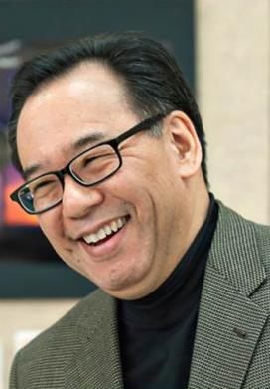
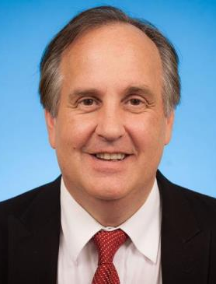
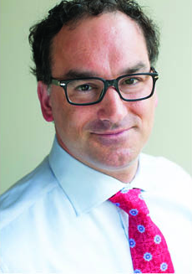
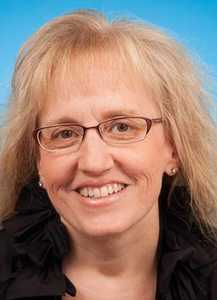
Vice Chairs, Medicine
Arno Kumagai
Vice-Chair, Education
Michael Farkouh
Vice-Chair, Research
Kaveh Shojania
Vice-Chair, Quality & Innovation
Sharon Straus
Vice-Chair, Mentorship,
Equity & Diversity

Slide 53
DoM Staff

Slide 54
Who to contact for what
Chair meeting/signatures: Rose at dom.chair@utoronto.ca
Research: joanna.king@utoronto.ca
Appointments/CPSO/Junior promotion: Tom and Shiva at dom.academicappts@utoronto.ca
Senior promotion: Lilian at dom.srpromotion@utoronto.ca
Continuing Faculty Appointment Review: Tom at dom.cfar@utoronto.ca
Money/Contracts/Other: clare.mitchell@utoronto.ca

Slide 55
Where to find us
190 Elizabeth St. R. Fraser Elliot Building Suite 3-805 Toronto, ON M5G 2C4 (Toronto General Hospital)
www.deptmedicine.utoronto.ca
@uoftdomchair

Slide 56
Mentorship Workshop
Dr Sharon Straus
Vice Chair, Mentorship, Equity and Diversity

Slide 57
Brief Closing Remarks

Slide 58
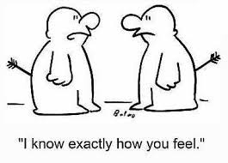
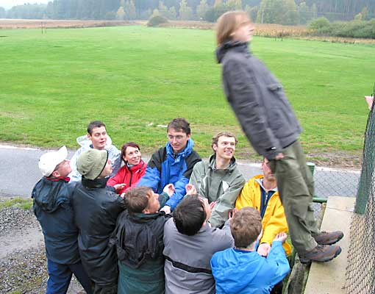
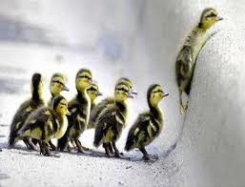
Ingredients for a Successful Academic Career
Notes:
Women’s
OA and OP

Slide 59
I’ve learned that people will forget what you said, people will forget what you did, but people will never forget how you made them feel. Maya Angelou, American author and poet

